Slide 1
Just the Facts
Identifying Fact from Opinion

Slide 2
Lesson Overview and Goals
identify the difference between facts and factual statements
understand how the concept of "truth" applies to what we know about facts
know when something moves from the realm of factual to opinion-based statements
apply the different types of opinions to their appropriate settings

Slide 3
Test Your Knowledge!
Answer questions 1-2 of the QUIZ: Facts vs. Opinions

Slide 4
What are facts?
Truth is the realm of the philosopher; Facts are the realm of the grammarian
An event, statement, or experience that is true
Except statements of fact can be wrong / false.
Intent vs. Truth
An occurrence in the real world
Are verifiable / correspond with experience
Even if they only happen once
Proof is preferred
But also on the page!
Cannot be disputed with logic
Acknowledged, not created or discovered

Slide 5
Facts vs. Factual Statements
Water boils at 100 degrees.
Water boils at 212 degrees Fahrenheit.

Slide 6
What facts are NOT
Opinions
Interpretations
Analysis
Truth
Opinions are judgements or beliefs about an experience
Interpretations are assumptions made about experiences
Analysis is a process of examining the structures and elements of our experiences
Truth is much trickier.

Slide 7
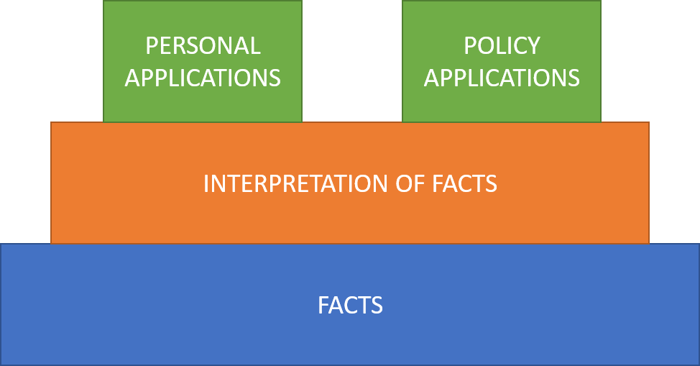
Facts need Context
Facts by themselves aren’t very helpful
Facts need to be interpreted to have value
Interpretation involves formal logic, critical thinking, and an understanding of truth
This is where many issues of fact/inference/opinion come up
We give meaning to facts by interpreting their implications and applications

Slide 8
Adding Opinions into the mix

Slide 9
What’s an opinion?
Plato distinguished between common belief (doxa) and certain knowledge
an opinion has a degree of subjectivity and uncertainty to it
certain knowledge is “certain” because it has proof
But “opinion” comes in 3 varieties:
tastes or preferences (reactions to experiences)
views about questions that concern most people such as ethics, politics, or faith (applications of facts)
views grounded in technical expertise, such as legal or scientific opinions
Notes:
You can’t really argue about the first kind of opinion.
The problem is that sometimes we assume opinions of the second and even the third sort to be unarguable in the way questions of taste are.
That’s one reason amateurs in any topic might feel inclined to disagree with content experts

Slide 10
No, You’re Not Entitled to Your Opinion
You are only entitled to what you can argue for
Some opinions can be proven wrong
Opinions are often used to shelter beliefs that should have been abandoned after seeing new evidence or listening to the factual experiences of others
You are entitled to hold any opinion you’d like, but that doesn’t mean those opinions
Should be treated as factual reality, unless with sufficient support
Should be measure equally against facts

Slide 11
Test Your Knowledge!
Answer questions in Parts 2-4

Slide 12
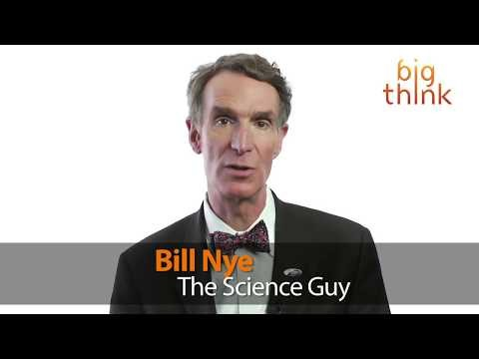
Then how do we debate anything?!
In order to have logical value, opinions should be centered around implications and applications, and supported by fact

Slide 13
Adding value to opinions
I believe tuna fish is a better lunch than yogurt.
In my experience, it rains more in Florida than in Washington.
Black holes hold the key to faster than light travel.
I believe thoughts and prayers do have value, even if they aren’t the only solution.
I don’t believe it is appropriate to teach children creationism in a contemporary science class.
Tuna fish provides nearly double the protein of a standard serving of yogurt, making it a better lunch choice to keep your body fueled throughout the afternoon.
Despite tuna’s higher protein levels, yogurt has a significantly lower impact of the environment due to the lack of hydrofarming and the rate at which yogurt can be produced. Opting for yogurt instead of tuna at lunch can help create a better world.

Slide 14
Test Your Skills!
Answer the final quiz questions

